Slide 1

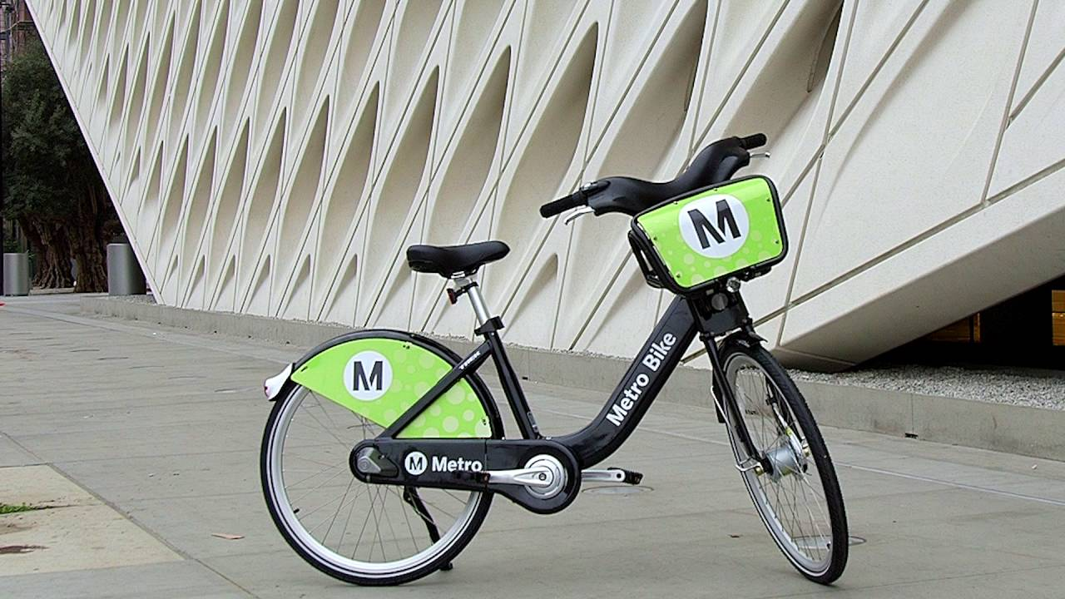
Bike’s Sharing Demand
By Yi Gao | Lin Liu | Ruiying Yang | Yuan Xin| Keren Li

Slide 2

Agenda
Introduction
EDA
Models
Predictions
03
04
14
28

Slide 3

Dataset Description
Metro Bike Share trip data
~ 1,300,000 trips
Time Horizon: 2016 Q3 (2016-07-07) ~ 2021 Q3 (2021-09-30)
Time Granularity: 1 minute (e.g. 2016-07-07 04:17:00)
Information about:
start time, end time, duration
start/end location, start/end station
bike type, passholder type, trip route category
Station Data:
region (Downtown LA/Pasadena/North Hollywood/Westside)
status (Active/Inactive)
Notes:
The main dataset is the metro bike share trip dataset. It contains data of around a million and three hundred thousand trips in LA. Data start from the July the 7th in 2016 (when the system launched) to the end of September in 2021, and data are provided in minutes. Basically, we obtain information about the duration of the trip given the start and end time, and we also know where the trip happened given the start and end location and station, and also additional information about bike type and passholder type. There is also another dataset about station information, including its region and status. So we merge the two datasets to incorporate all information.

Slide 4

Exploratory Data Analysis

Slide 5
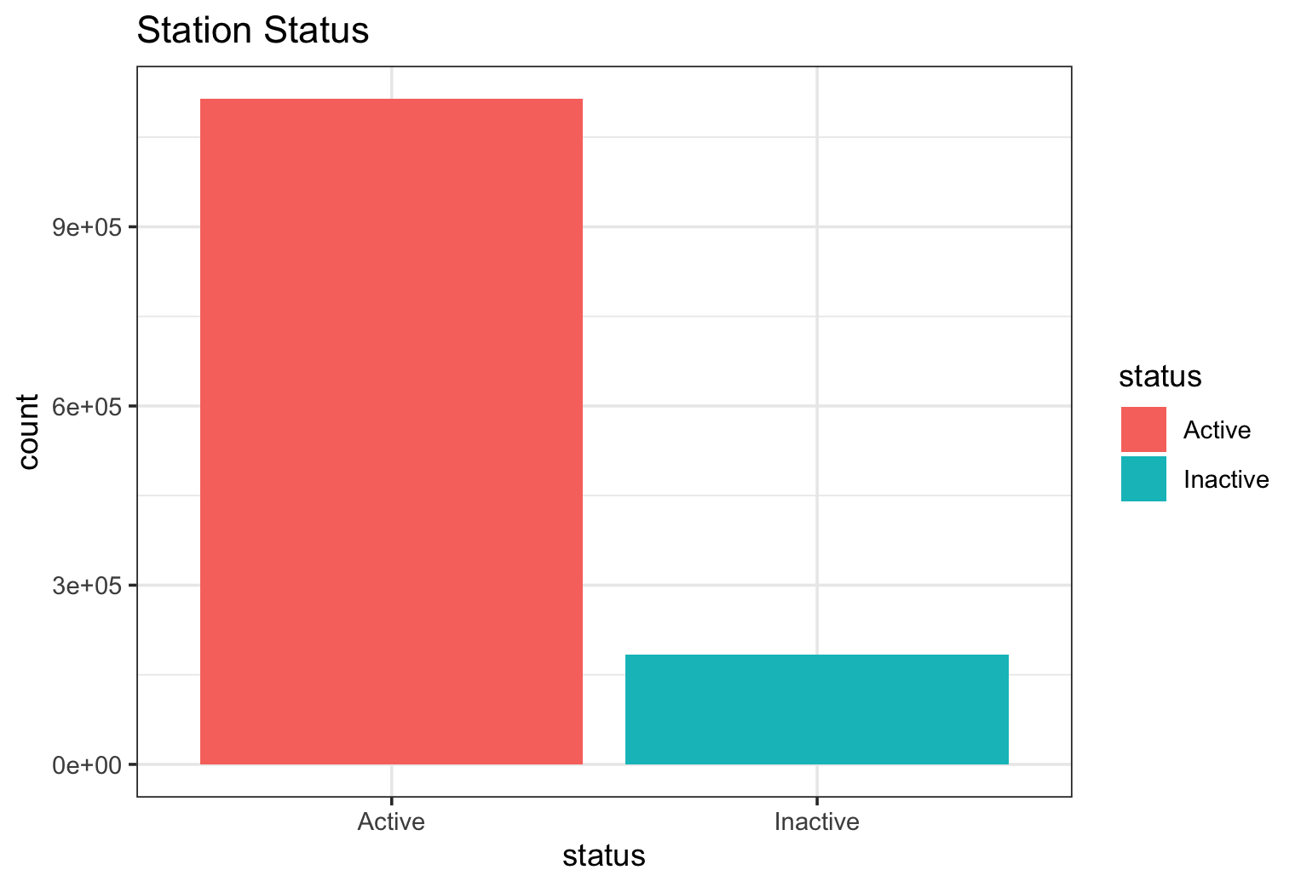
Station status
85% active stations
15% inactive stations
Notes:
Firstly, we take a quick look at the station status. 85% of the stations are active and when we do predictions, we probably want to exclude the inactive stations.

Slide 6
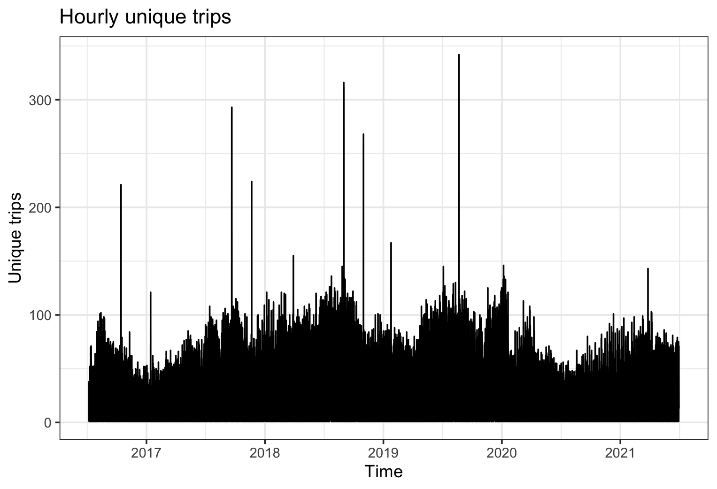
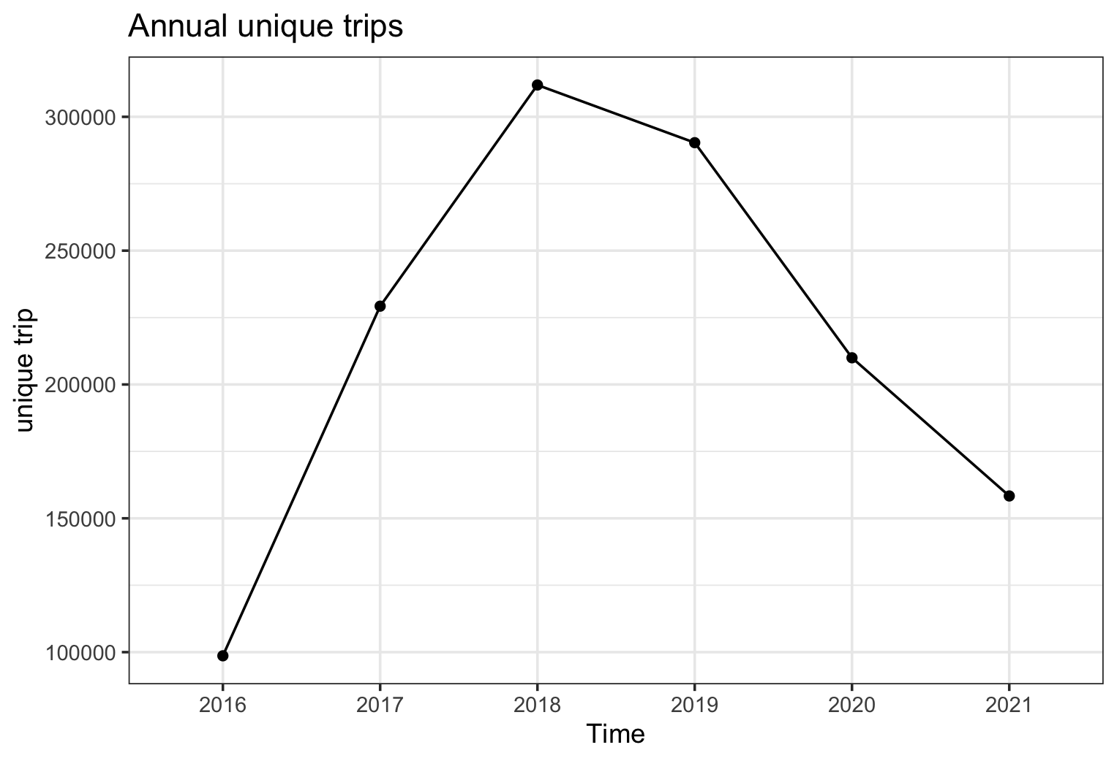
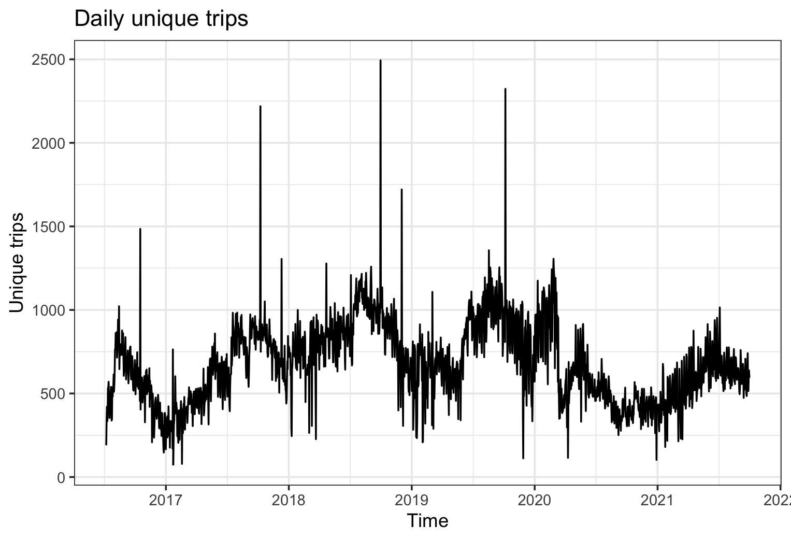
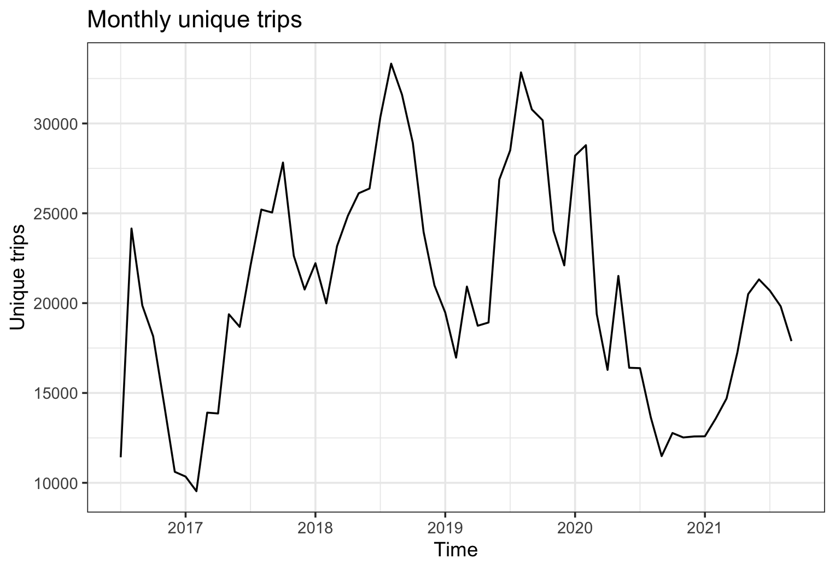
Demand (count of unique trips)
Notes:
Then we dive directly into demands. Here we show the hourly, daily, monthly and annual demand, just by counting the number of unique trips within each time horizon. We can’t tell much from higher frequency demand but we can observe some seasonal trends, it looks like there is monthly seasonality.
Overall level of demand keep increasing from 2016 to 2018, and then it start to decrease. The largest decreases happened in the first quarterly of 2020, which may largely due to COVID impact.

Slide 7
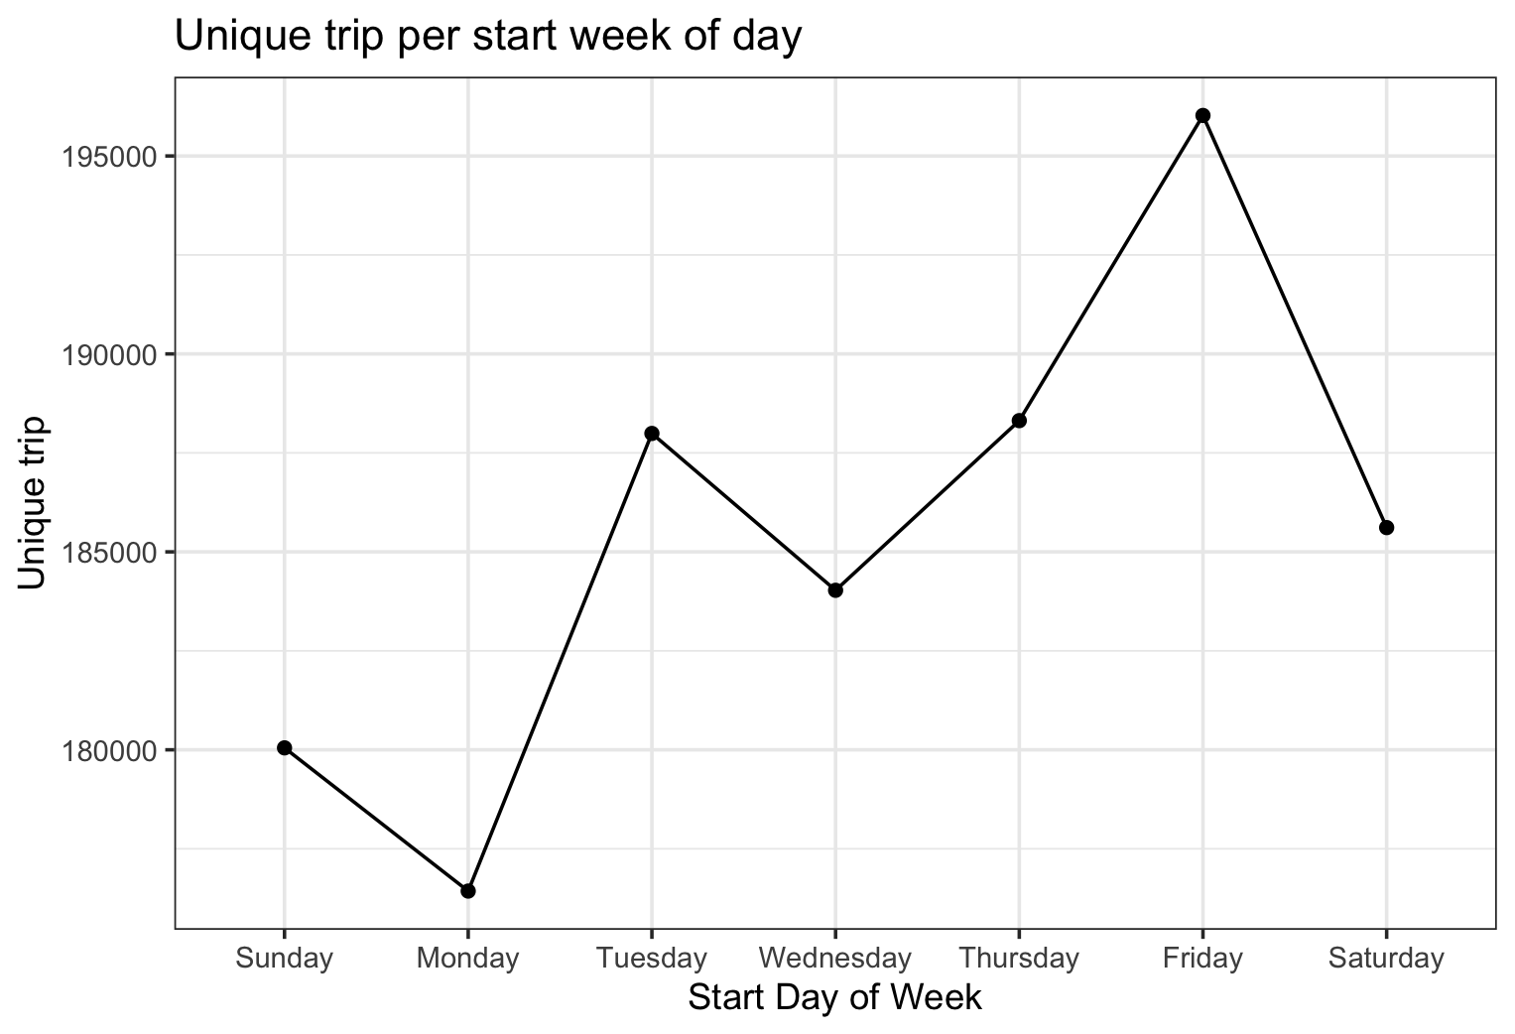
Demand
Fridays Seem to have the most demand, and Mondays have the lowest demand.
Notes:
We also look at demands in each day of the week. So Friday seems to have the most demand and Monday has the lowest.
Next, I will pass onto Keren to continue our EDA.

Slide 8
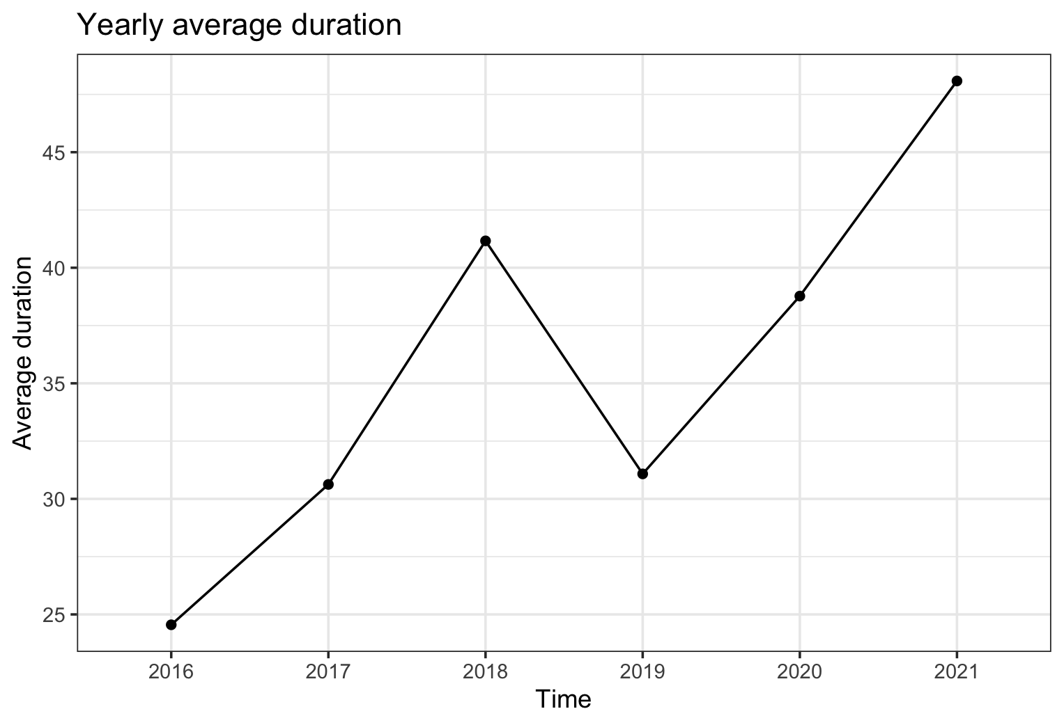
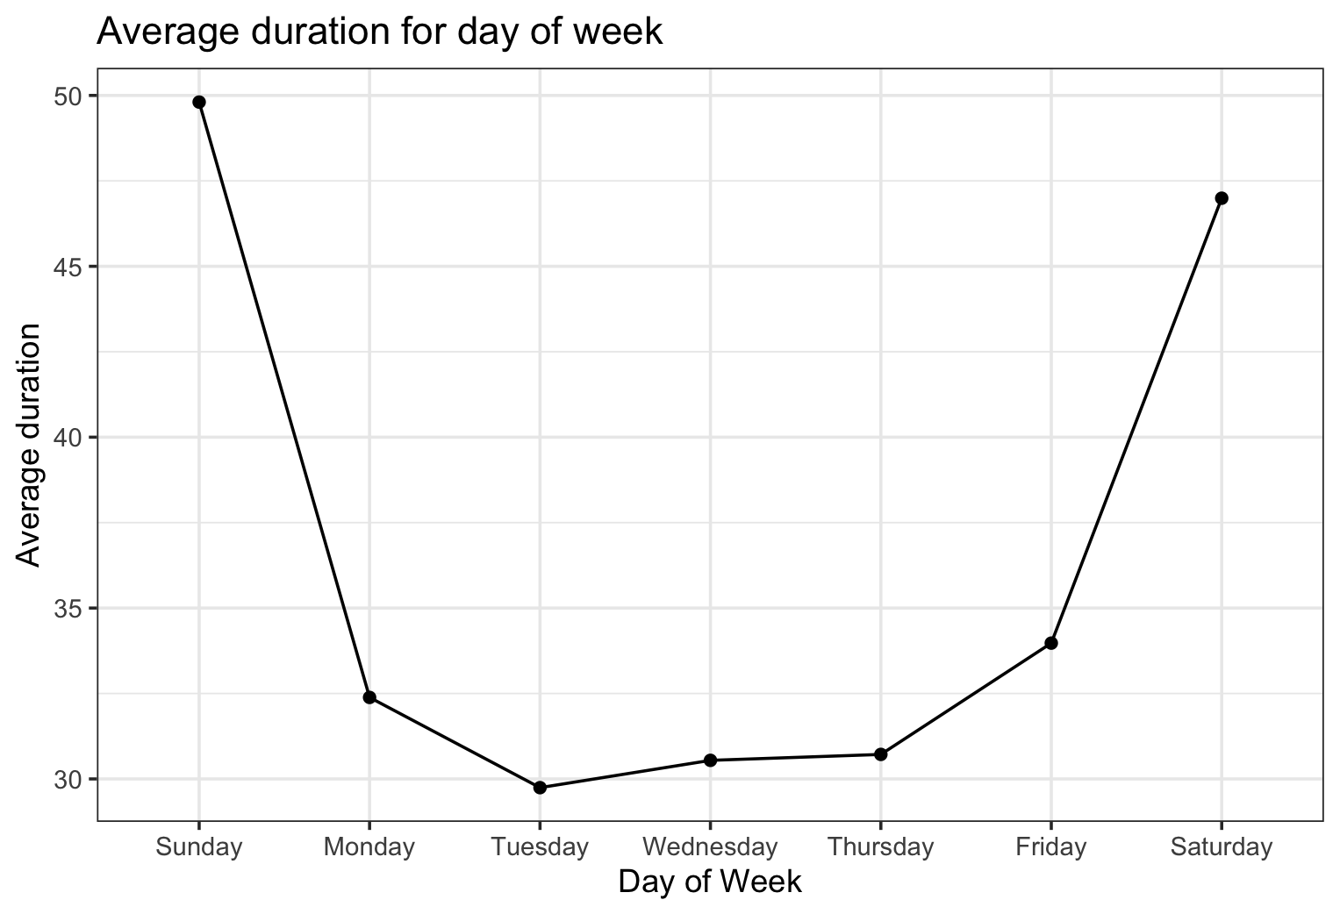
Average trip duration
Average duration for each year has been increasing since 2019.
Trips in weekends have longer duration than trips in weekdays.
Notes:
Thank yu Lin.
Besides demand, we analyzed the average trip duration.
Average duration for each year has been increasing since 2019. 2021 has the longest average duration, which is more than 45 mins per trip.
In addition, we found that

Slide 9
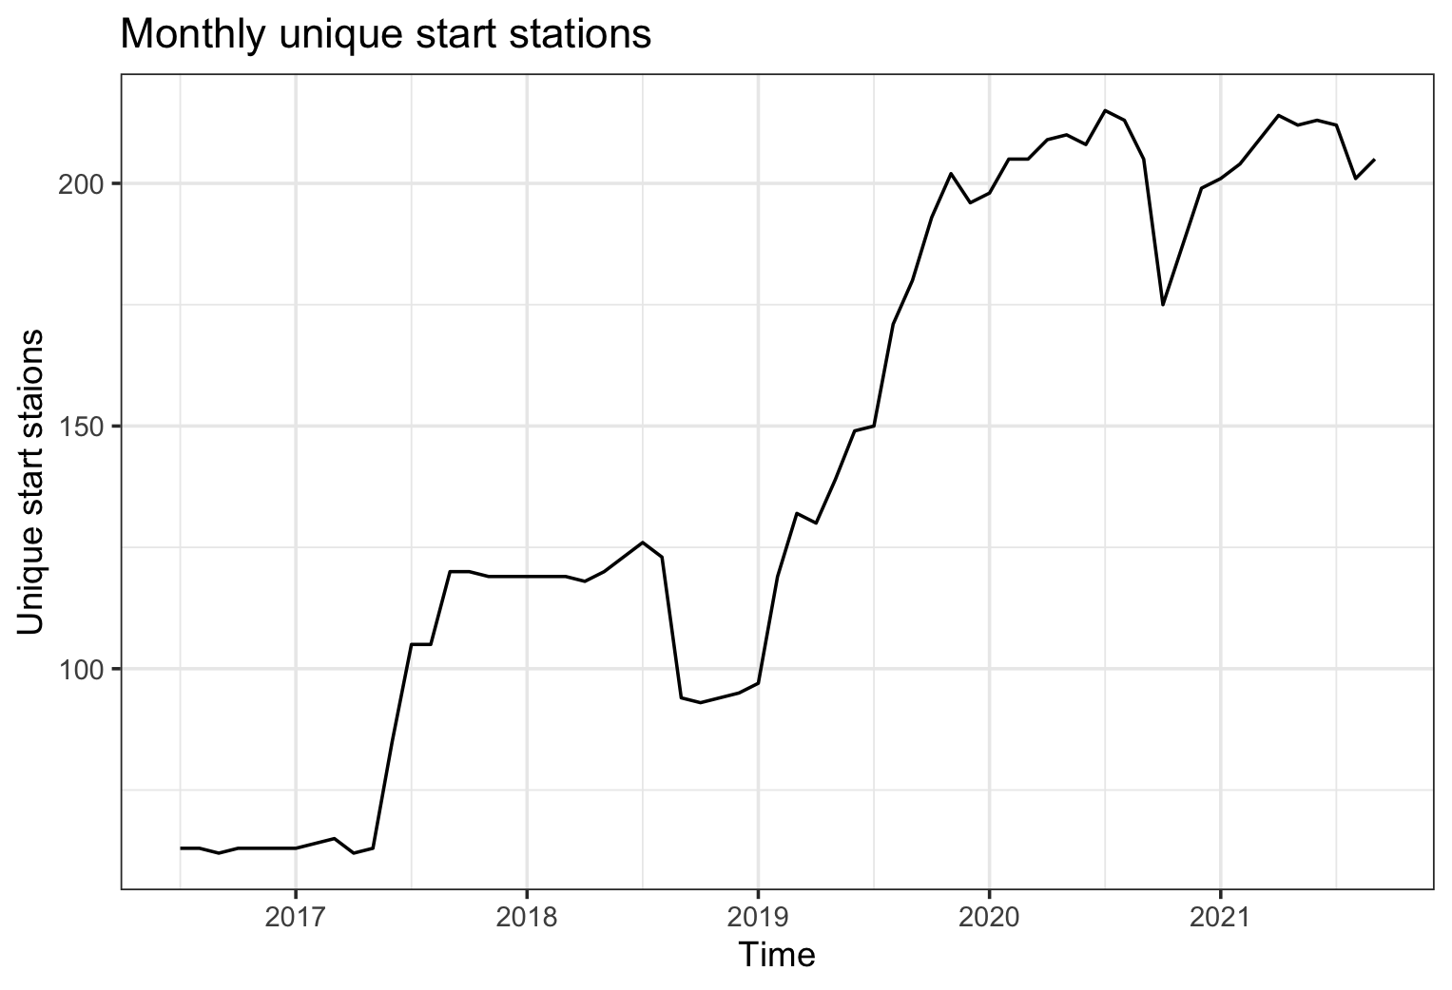
Unique start station
More stations were built starting 2019.
Notes:
We did analysis on unique start station as well/
Users in the past 2 yrs rent bikes from much more different start stations than users in previous years.
# -> It infers that more stations were built in the past two years.

Slide 10
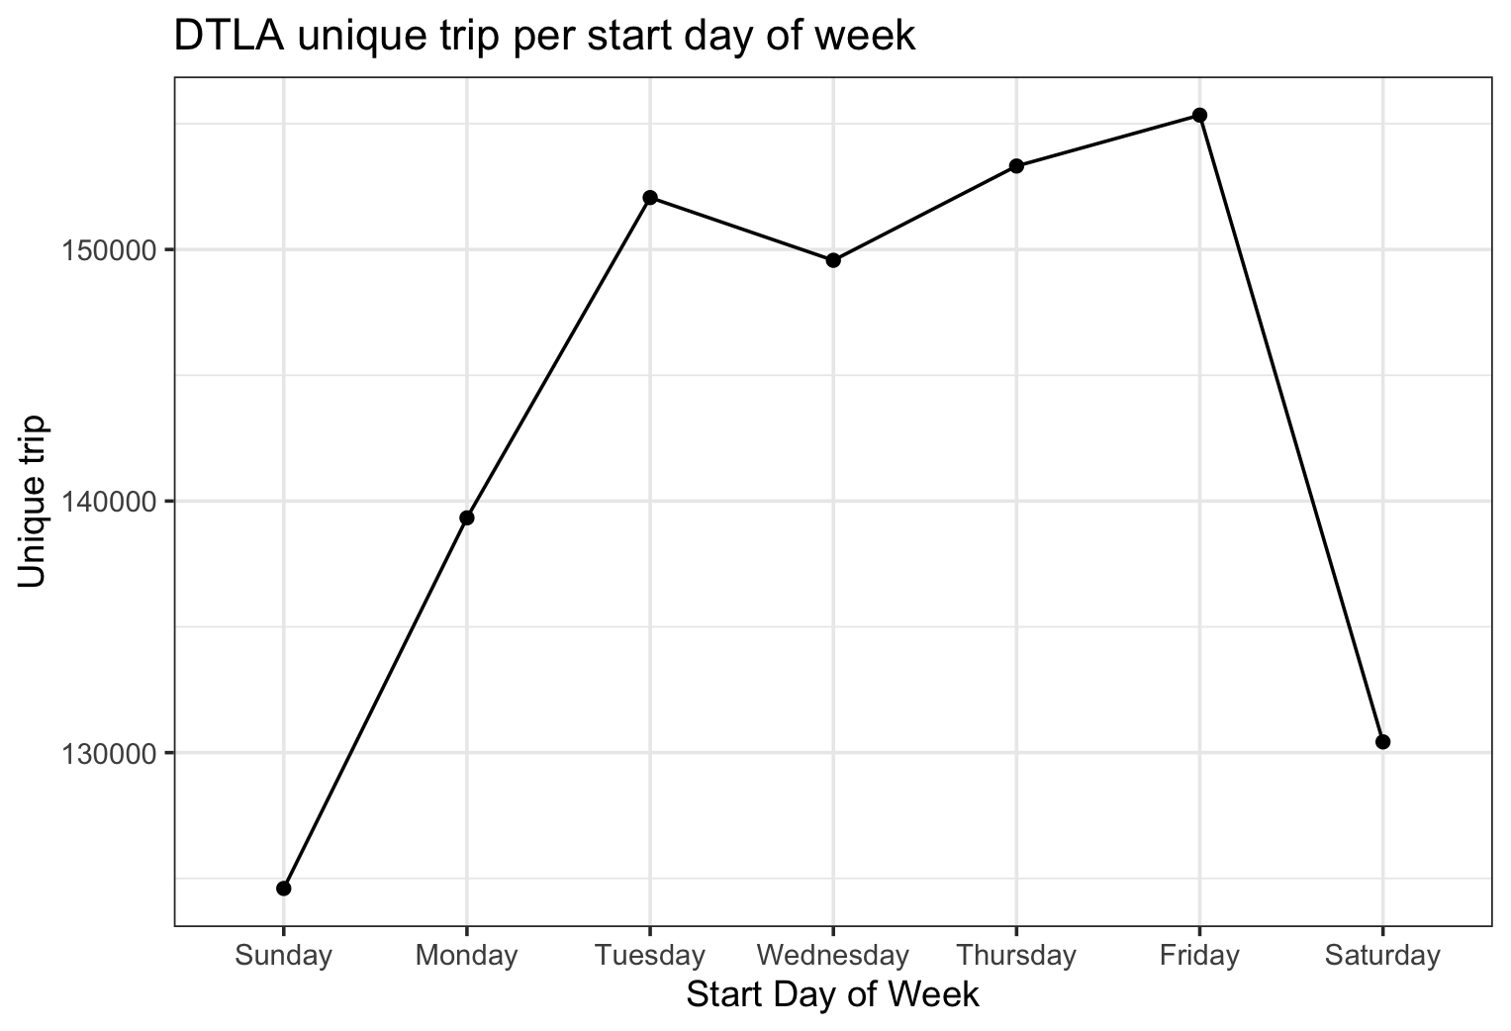
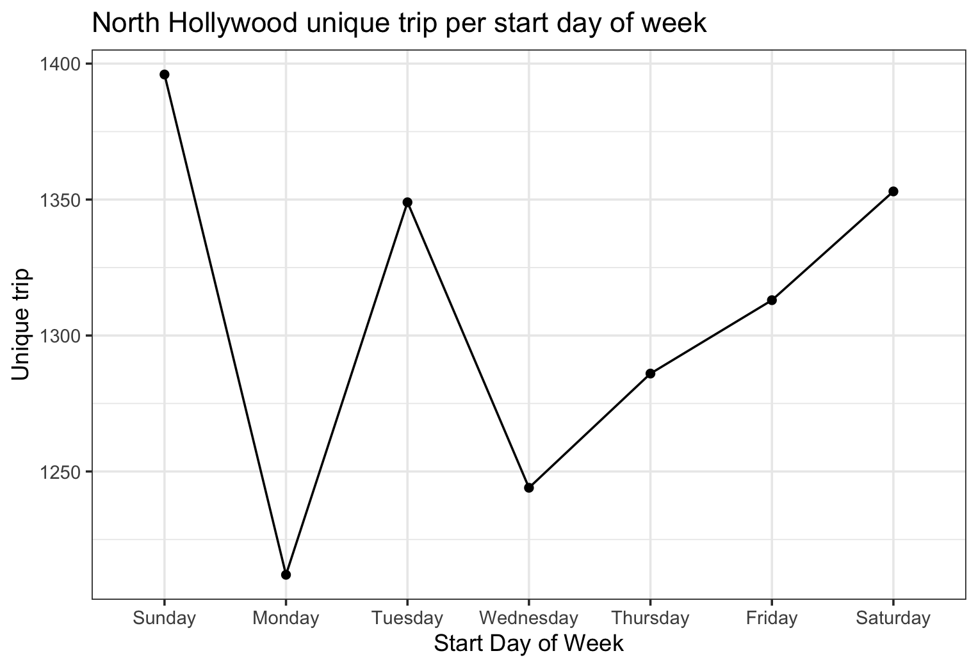
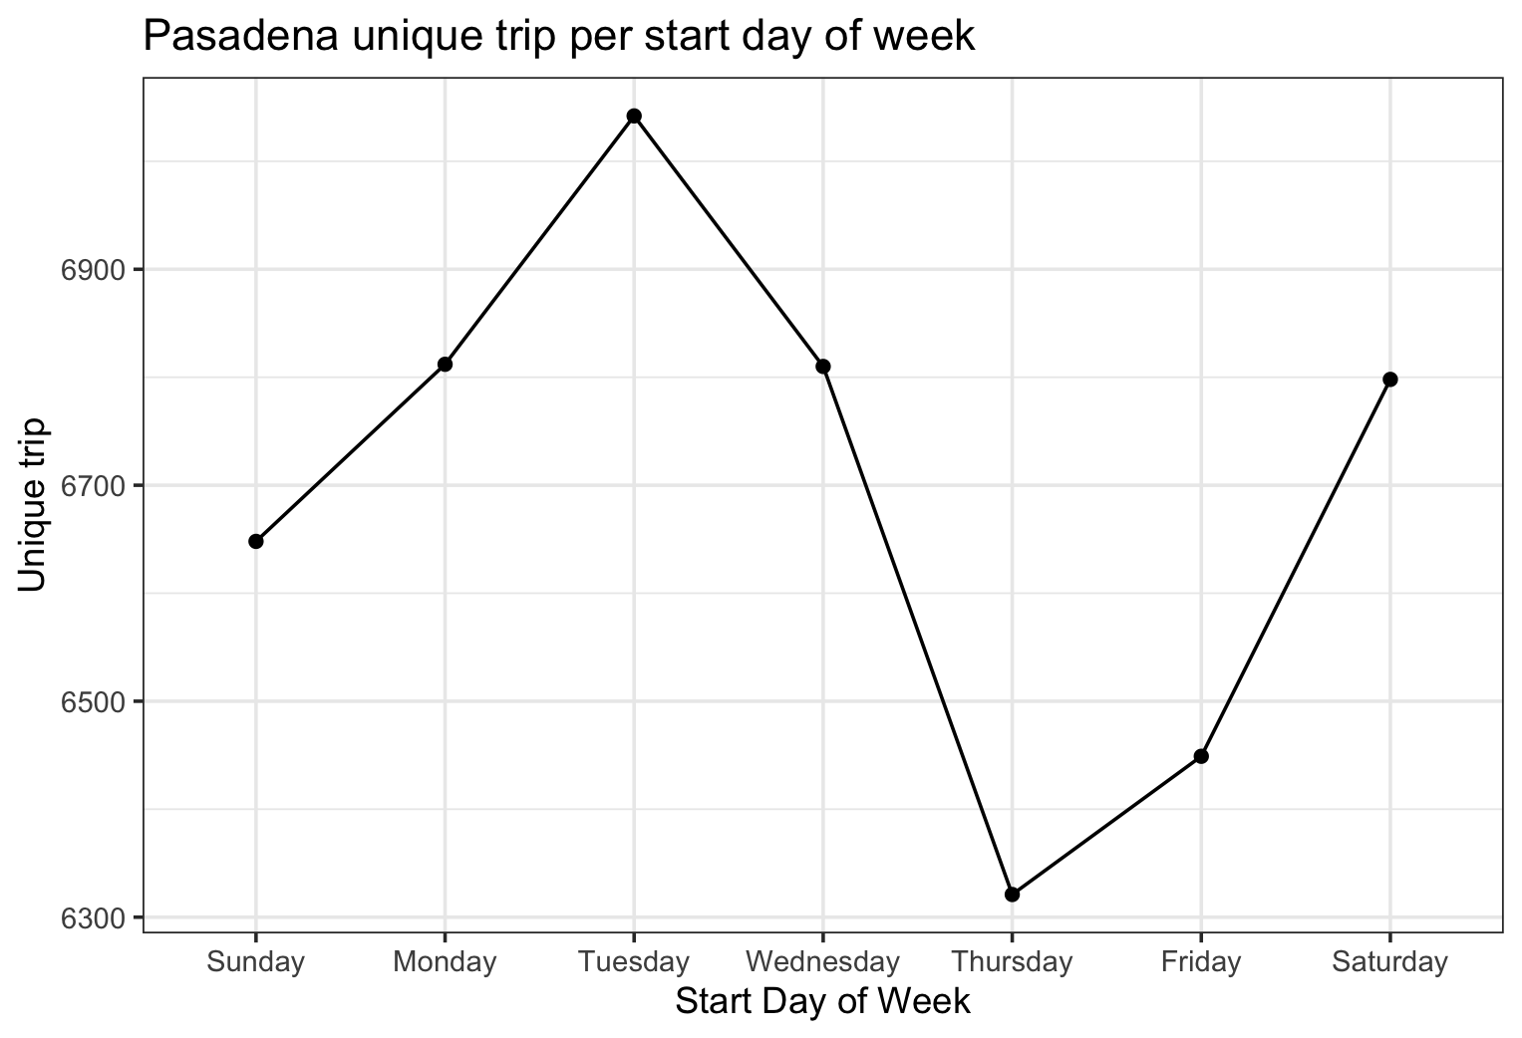
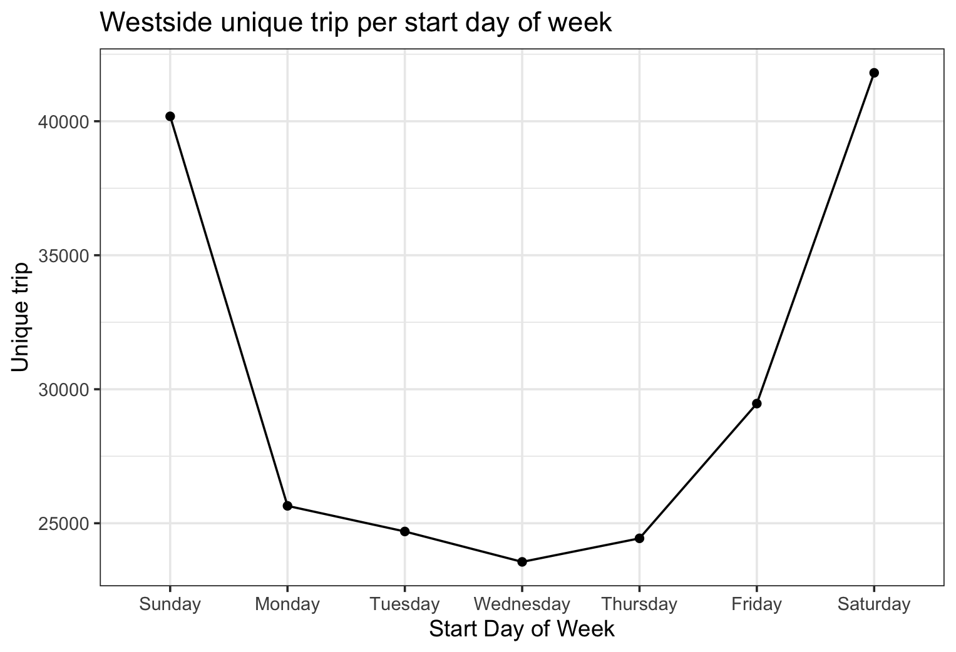
How different locations perform differently?
Notes:
We first look at their demand per day of week. Each location has different scenarios.
#-> For DTLA, weekdays seem to have much more demand than weekends.
#-> For Westside, weekends have much more demand than weekdays.
#-> For Pasadena, Tuesdays have the most demand, and Thursdays have the least demand.
#-> For North Hollywood, weekends seem to have more demand than weekdays. Mondays have the least demand.

Slide 11
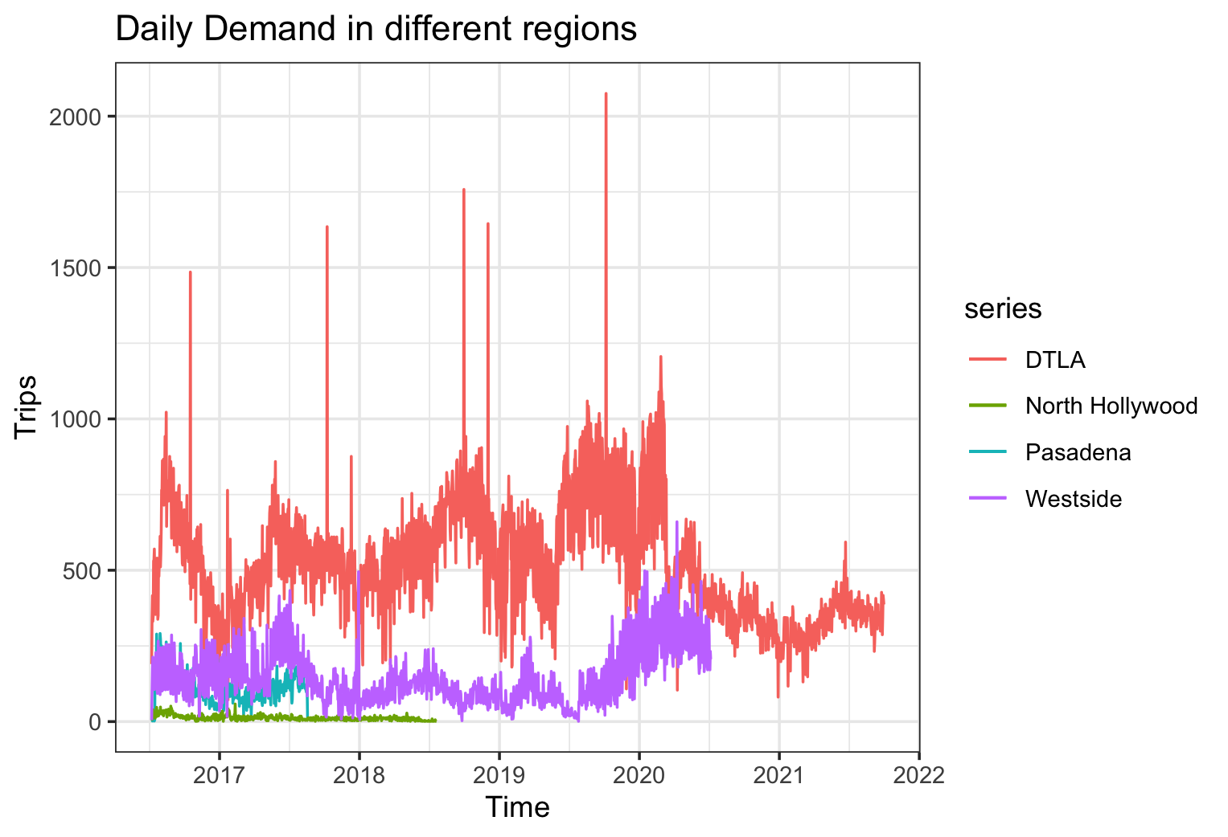
Demand in different regions
DTLA has the highest demand, while demand decreases drastically stating 02/2020, maybe due to COVID.
North Hollywood has the lowest demand.
Source: Statista.com, 2021
Notes:
Then we look at the daily demand in general

Slide 12
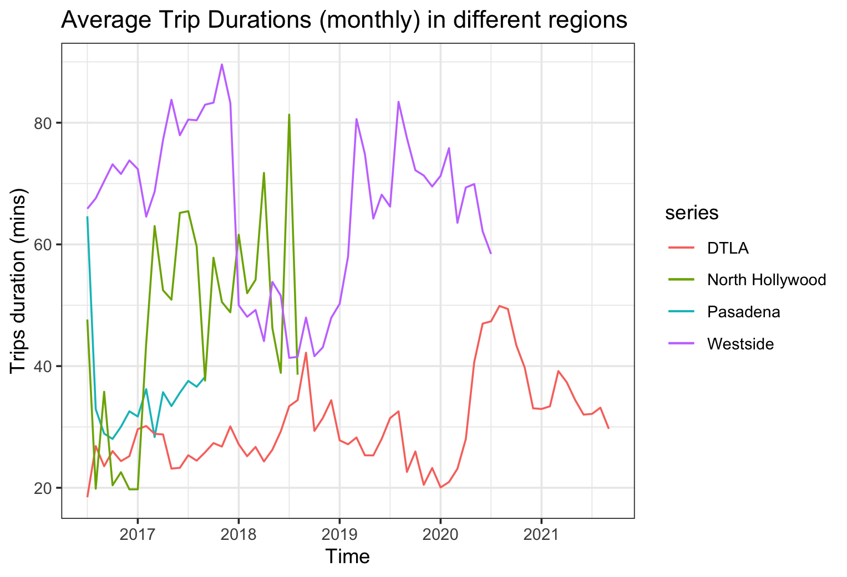
Average trip durations in different regions
Trips in Westside and North Hollywood have longer duration than trips in DTLA.
Source: Statista.com, 2021

Slide 13
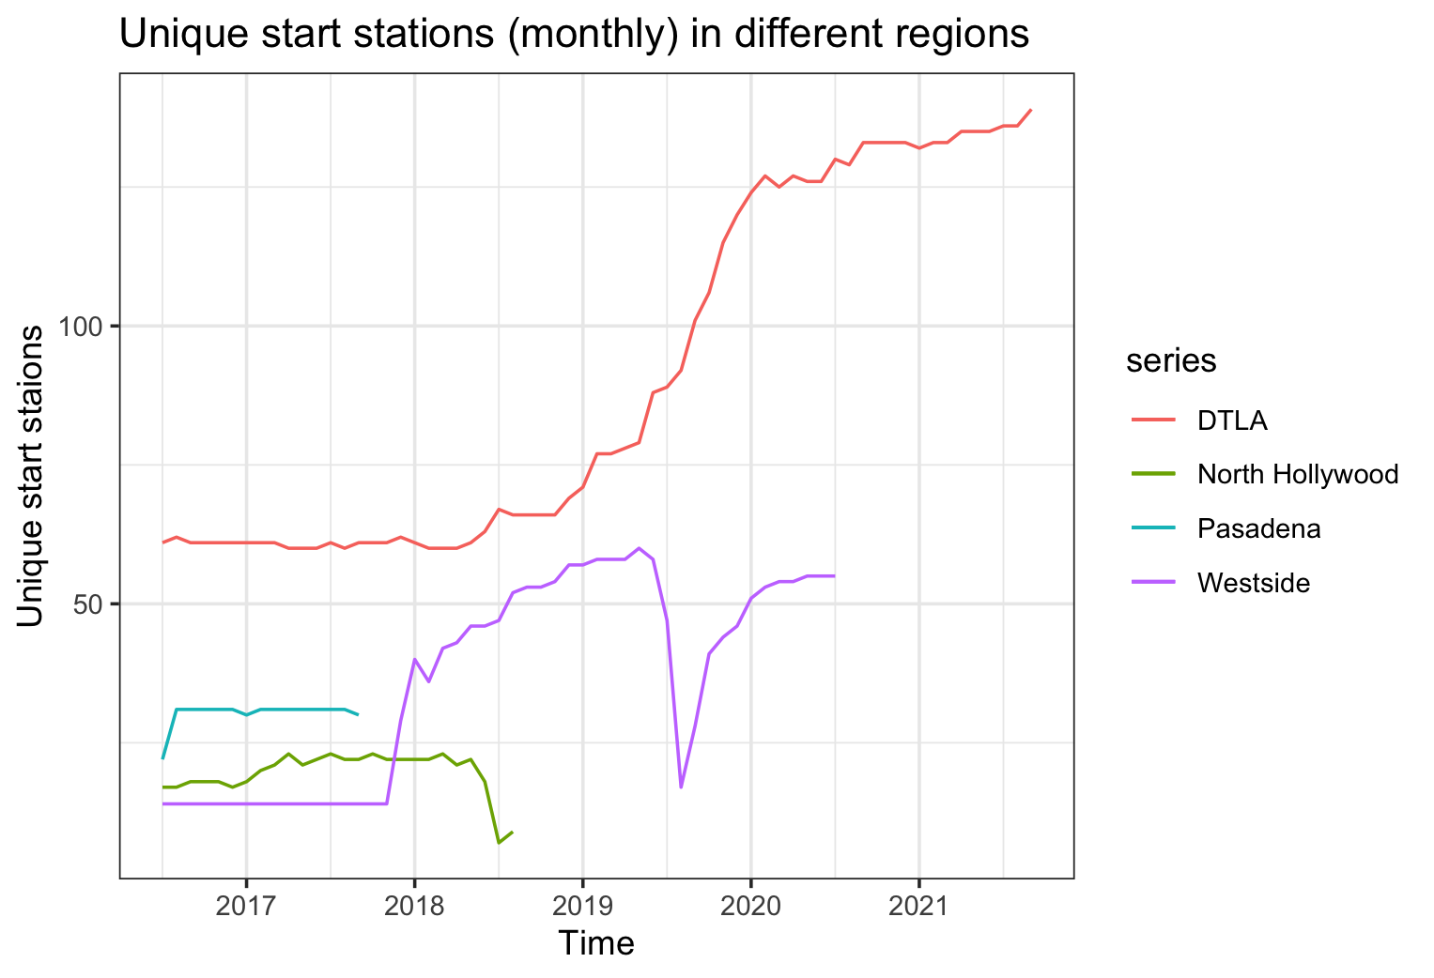
Unique start stations in different regions
DTLA has more unique start stations. More new stations were built starting 2018.
There are only few stations in Pasadena and Westside, which aligns with the demands
Source: Statista.com, 2021
Notes:
# -> DTLA has more unique start stations, and significantly more new stations were built starting 2018.
# -> We notice there was a sharp decrease of unique start station in Westside in 2019 3rd quarter.
# -> There are only few stations in Pasadena and Westside, which aligns with the demands

Slide 14
Models

Slide 15
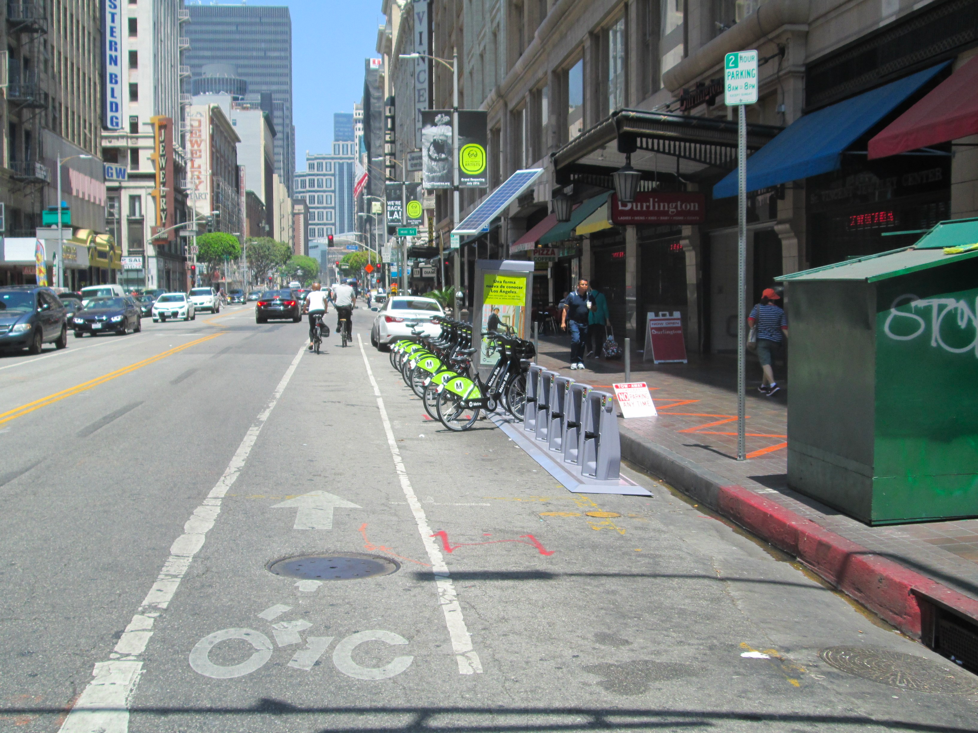
Model # 1:
Multiple seasonal decomposition
-- Method: Arima

Slide 16
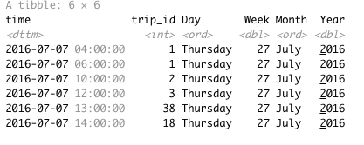
Data Processing
Train: before 06/30/2021
Test : 07/01/2021 -- 09/30/2021 (Q3 2021 )
Select DTLA region and station status is “Active”
Group by “start date hour”, and count trip id as y dependent variable.
Multiple seasonality: Use year, month and day and hour to train the model

Slide 17
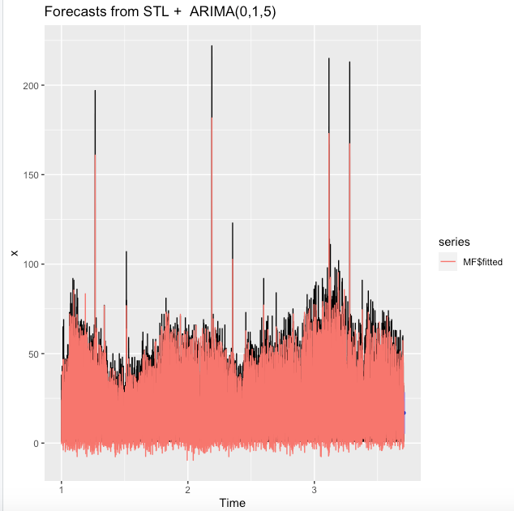
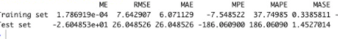
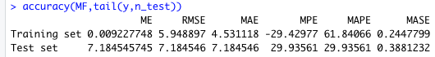
Multiple seasonal decomposition--
Method: Arima
Time Range 6am- 10pm :
Time Range 24 hour :
Final Result RMSE is 7.18 on testing dataset.

Slide 18
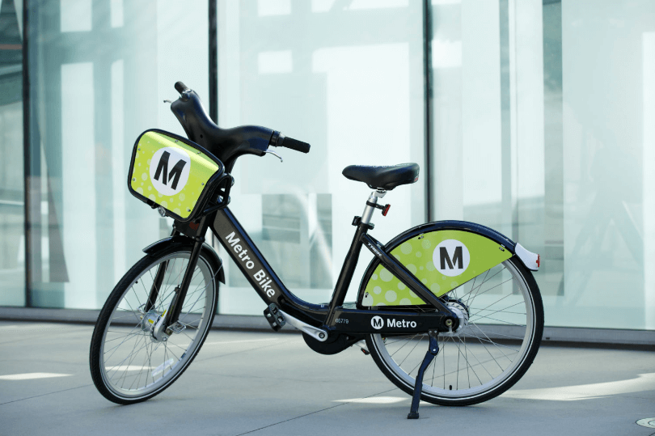
Model # 2:
Linear Regression

Slide 19
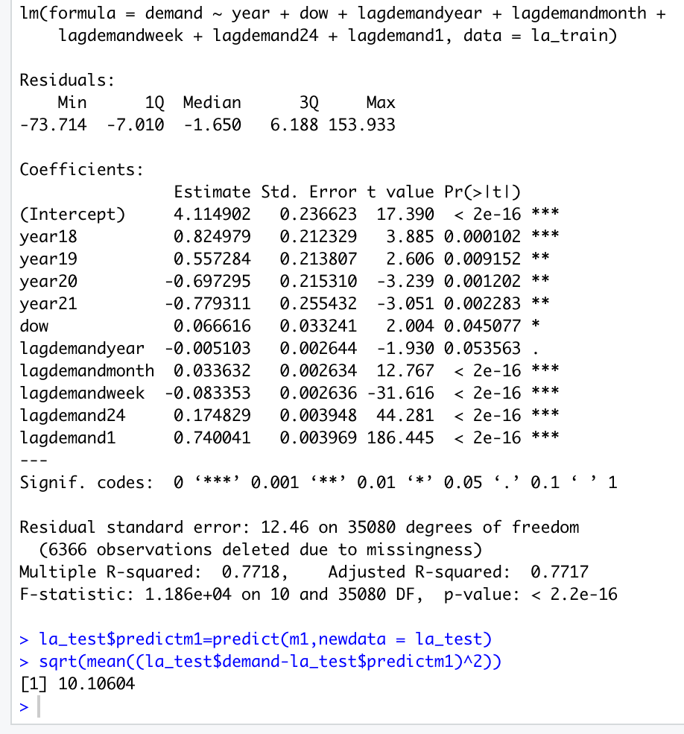
MODELING ON LAGGED DEMAND
We also added variables such as trend, month, day of week,year variables as the predictors.
But we ruled out some during the modeling process when they exhibit statistically insignificant p values.
we originally set the lagged value for 6 time periods :
1 hour ahead
1 day ahead
7 day ahead
1 month ahead
6 month ahead
1 year ahead
And after we removed insignificant predictors:
R^2 of 77%,
RMSE on testing dataset: 10.10

Slide 20
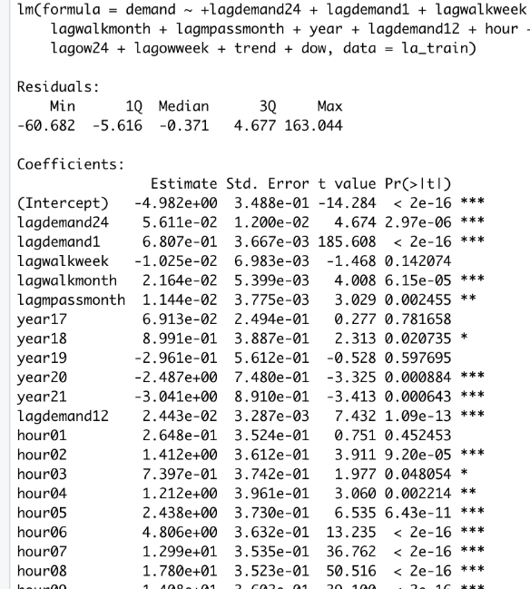
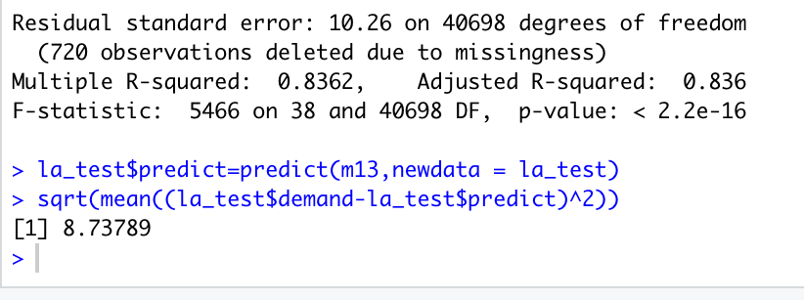
MODELING PASS & TRIP_ROUTE
We also noticed in the original data frame there are variables like passholder_type and trip_route_category that can be formatted in to prediction models:
we count each subcategory’s frequency according to start_date and also calculated lagged values for the same time periods:
1 hour ahead
1 day ahead
7 day ahead
1 month ahead
6 month ahead
1 year ahead
And after we removed insignificant predictors:
R^2 of 84%,
RMSE on testing dataset: 8.74
HOWEVER, WE MAY NOT APPLY THIS MODEL FOR FORECAST:
since we are predicting future quarter(q4) values, we do not have enough info of pass&trip route. But this model could be useful if to predict short term demand.
Notes:
Here are the two reasons behind.
- As you can see on the left graph, which shows the age breakdown of current Spotify customers in the US, customers.....
- Spotify customers aging under 30 have a much higher satisfaction towards Spotify as an brand,
so in general, it would easier to convert this group of people from ad-supported users to Premium subscribers.

Slide 21

Model #3:
ARIMA & Neural Networks
with Triangular Function
modeling multiple seasonality
Notes:
The third strategy we recommend is to integrate Spotify’s streaming service with other platforms or products.

Slide 22
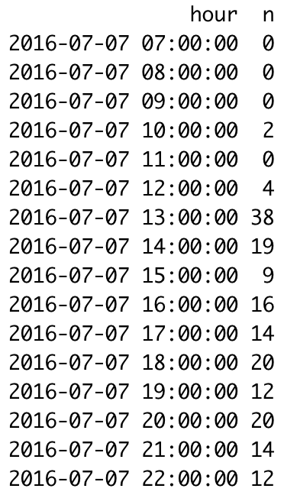
Scenario 1: Filtering out night hours w/ low demand
16 hours per day
7:00 AM to 10:00 PM
Fill missing hours with 0’s

Slide 23
ARIMA Model
y = msts(demand_DTLA$demand, seasonal.periods=c(16, 16*7, 16*365.25))
y.test = 2021 Q3
M = auto.arima(y.train, seasonal = F, xreg=fourier(y.train, K = c(i, j, k)), lambda="auto")
Loop through different combinations of i, j, and k
Best maximum order of Fourier terms is (2 2 3)
RMSE = 6.68

Slide 24
Neural Network Model
y = msts(demand_DTLA$demand, seasonal.periods=c(16, 16*7, 16*365.25))
y.test = 2021 Q3
M = nnetar(y.train, seasonal = F, xreg=fourier(y.train, K = c(i, j k)), MaxNWts=4279)
Loop through different combinations of i, j, and k
Best maximum order of Fourier terms is (1 1 4)
Model: 20 networks, each of which is a 45-23-1 network with 1082 weights
RMSE = 7.23

Slide 25
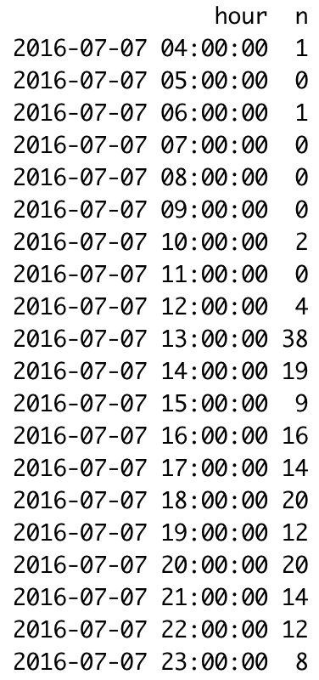
Scenario 2: impute missing data with 0’s
Construct a table with consecutive hours
Left join hourly demand
Replace NA’s with 0’s

Slide 26
ARIMA Model
y = msts(demand_DTLA$demand, seasonal.periods=c(24, 24*7, 24*365.25))
y.test = 2021 Q3
M = auto.arima(y.train, seasonal = F, xreg=fourier(y.train, K = c(i, j, k)), lambda="auto")
Loop through different combinations of i, j, and k
Best maximum order of Fourier terms is (2 2 3)
RMSE = 5.84

Slide 27
Neural Network Model
y = msts(demand_DTLA$demand, seasonal.periods=c(24, 24*7, 24*365.25))
y.test = 2021 Q3
M = nnetar(y.train, seasonal = F, xreg=fourier(y.train, K = c(i, j k)), MaxNWts=4279)
Loop through different combinations of i, j, and k
Best maximum order of Fourier terms is (1 1 4)
Model: 20 networks, each of which is a 48-24-1 network with 1201 weights
RMSE = 5.51
This is our Champion model

Slide 28
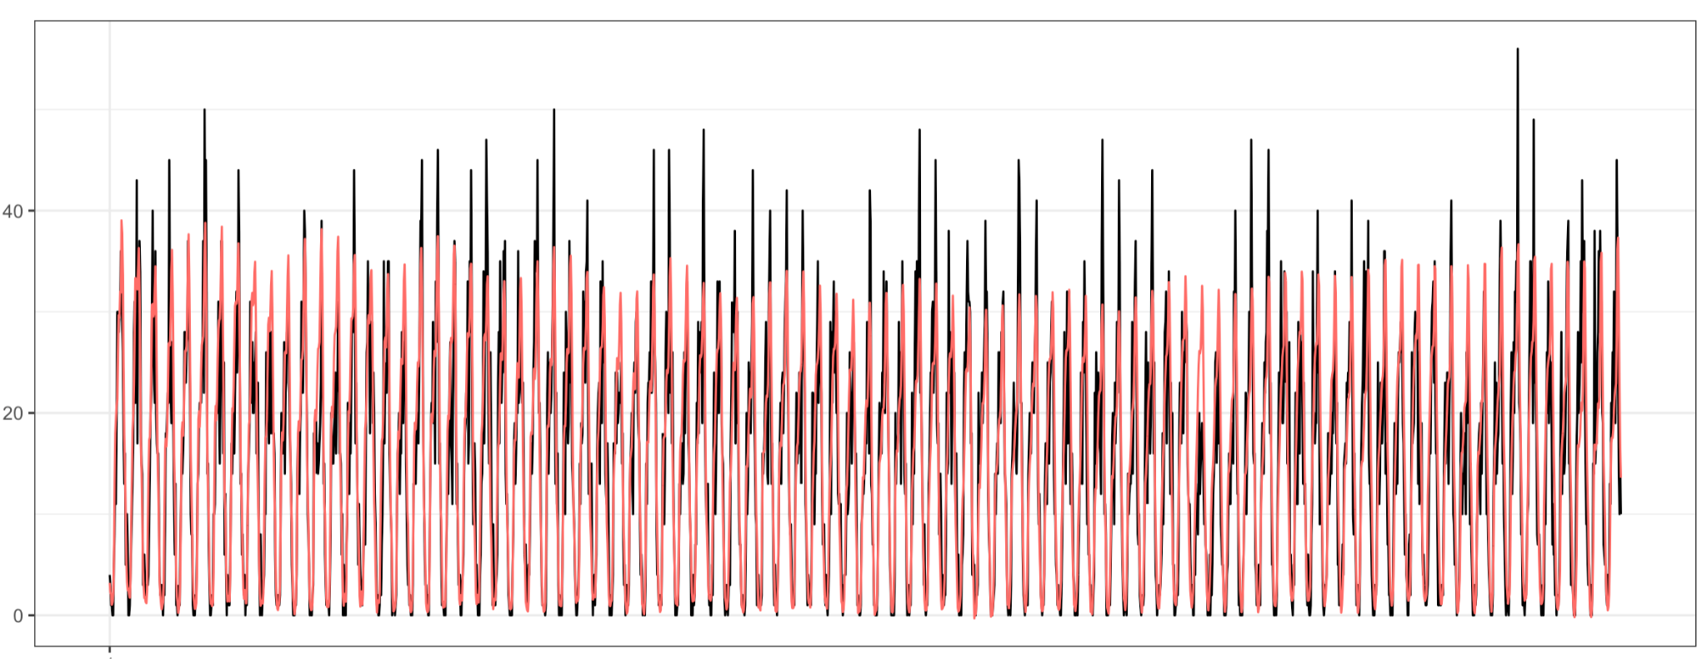
Forecast on testing set - 1 quarter

Slide 29
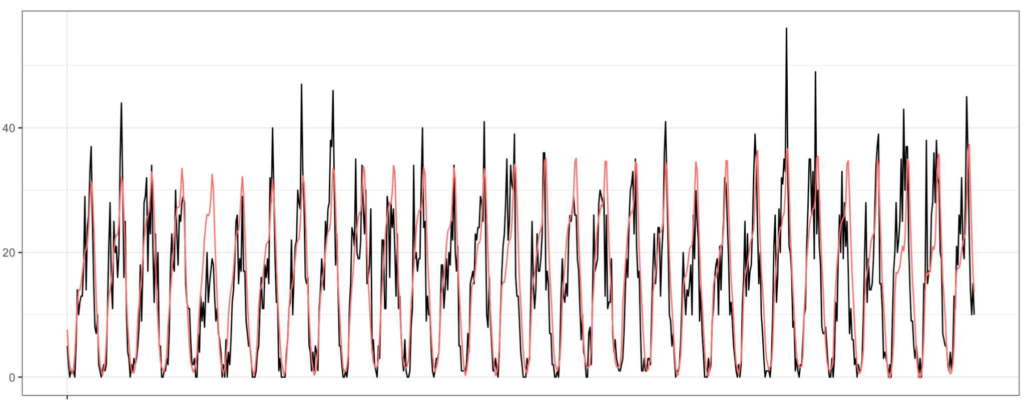
Forecast on testing set - 1 month

Slide 30
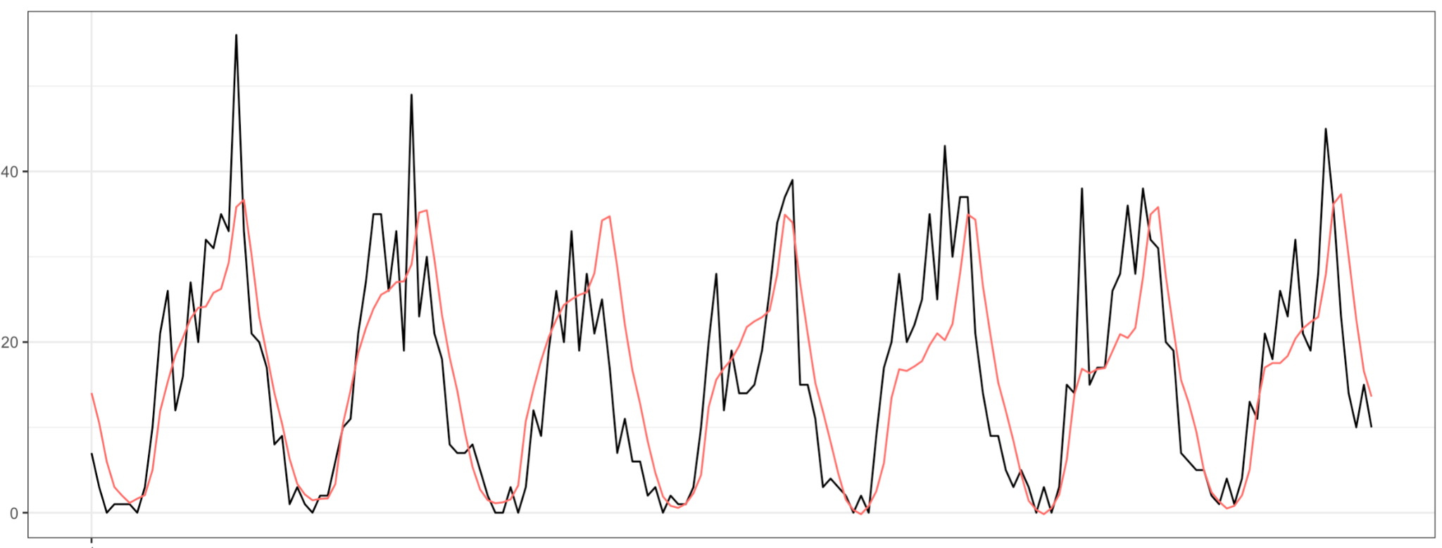
Forecast on testing set - 1 week

Slide 31
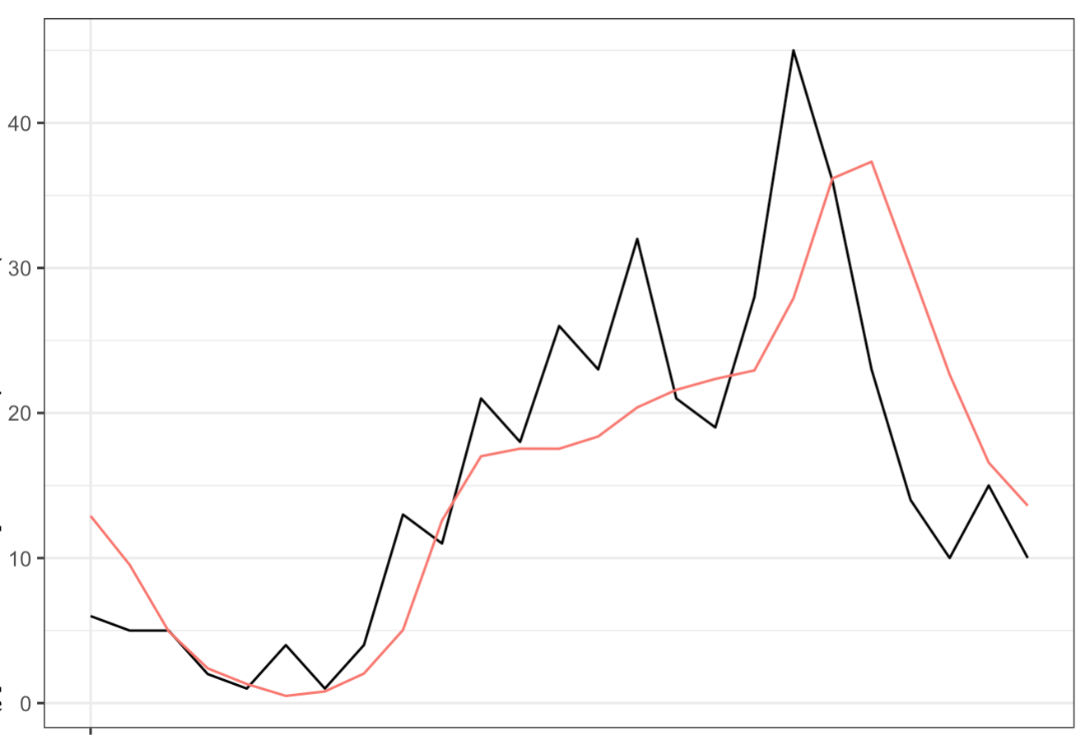
Forecast on testing set - 1 day

Slide 32
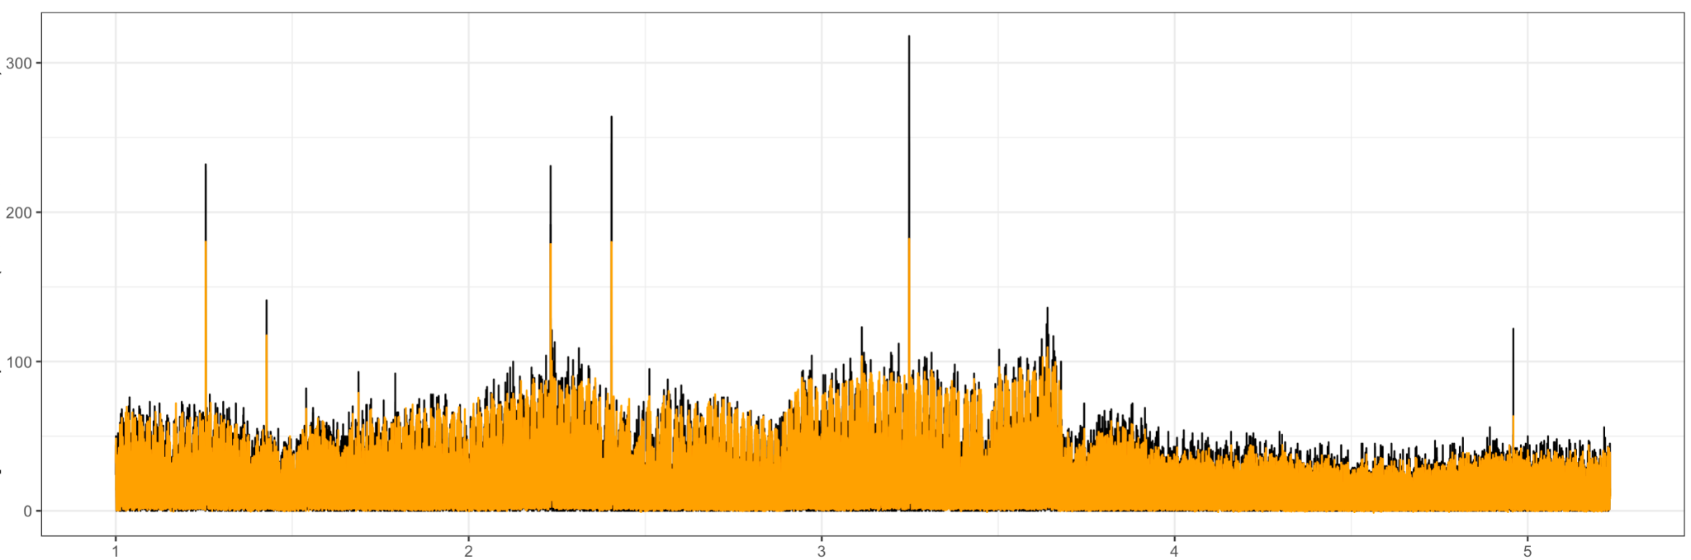
Fitting on all available data

Slide 33
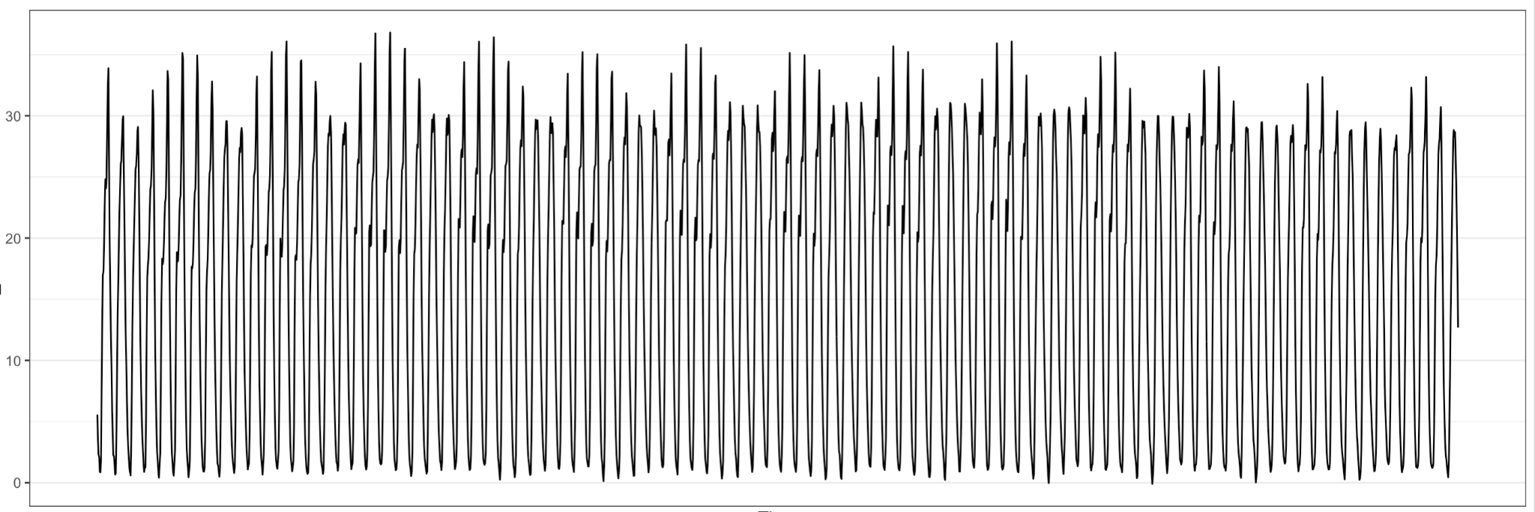
Predicting 2021 Q4 demand

Slide 34
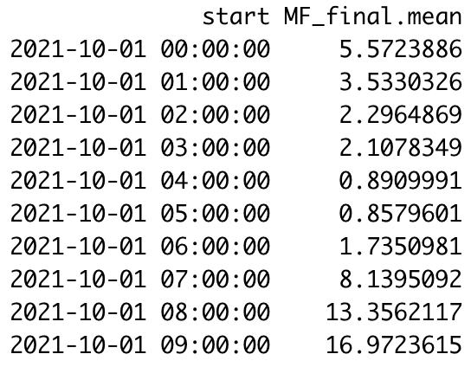
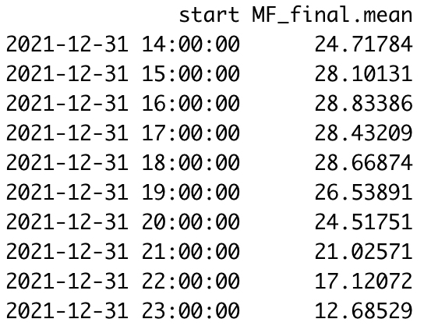
Predicting 2021 Q4 demand

Slide 35
THANK YOU
Notes:
We hope our presentation provides useful information to you or inspires more thought of you. Thank you for listening, now we are open to any question you may have.

